Slide 1
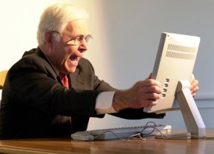
No voice training required!
Bringing speech to the web...
[http://i.huffpost.com/gadgets/slideshows/18247/slide_18247_253781_small.jpg12_speaker_headphone]
= Voice-controlled web browsing for the elderly =

